Slide 1
Growth & Growth Monitoring
A growing child is a healthy child
Prof A Pathmeswaran
Department of Public Health

Slide 2
Growth & Growth Monitoring
What is growth?
Factors affecting growth
Growth monitoring
  What to monitor?
  How often?
  Standards
  Reference values
  Growth charts
Growth and health

Slide 3
Growth
What is growth?
  An increase in size/ mass, mostly due to an increase in the number of cells
What is development?
  Maturation of function

Slide 4
Fetal Growth
Ovum to infant 42 rounds of cell division
After birth 5 more rounds
Variation between tissues in terms of number of rounds and timing

Slide 5
Healthy Child
Appropriate development
Appropriately active
Well nourished
Free of infection
Happy

Slide 6
Growth
Period of rapid growth up to the end of the 2nd year
Continues at a steady rate until puberty
Pubertal growth spurt
Slows down after that and stops around 16 years in girls and 18 years in boys

Slide 7
Factors Affecting Growth

Slide 8
Factors Affecting Growth
Heredity & Ethnicity
Nutrition
Disease
Emotional factors
Endocrine and metabolic factors
Causes & causes of causes

Slide 9
Growth Monitoring
Regular measurements made to assess growth (and intervene when necessary)
What to measure?
Monitoring

Slide 10
Weight
Average birth weight 2.9 kg
A newborn loses about 10% of its birth weight following birth
Regains the birth weight by 10 to 14 days of life
Average weight gain during first 3 months is about 30 g per day
3-6 months 20 g per day

Slide 11
Weight
A newborn doubles its birth weight by 5 months and triples (x3) it by 1 year of age
Birth weight is quadrupled (x4) at 2.5 years

Slide 12
Length
Newborn measures 50 cm at birth
Increases by 25-30 cm in the first year
6-8cm yearly, after that
The birth length doubles by 3-4 years of age, and it triples by 13 years of age

Slide 13
What to measure?
Weight
Height
Head circumference
Chest circumference
Mid arm circumference??

Slide 14
What to measure?
Weight (rapid change, easy, can decrease)
Height (total previous growth, __, __)
Head circumference
Chest circumference
Mid arm circumference??

Slide 15
How Often?
Birth to 2 years – Once a month
2 yrs – 5 yrs - Once in three months

Slide 16
Standards
NCHS (National Center for Health Statistics - USA)
WHO (World Health Organization)
  Valid?
? Applicability to Sri Lankan children?

Slide 17
Growth and Health
Thrifty gene hypothesis
Thrifty phenotype hypothesis/ fetal programming

Slide 18
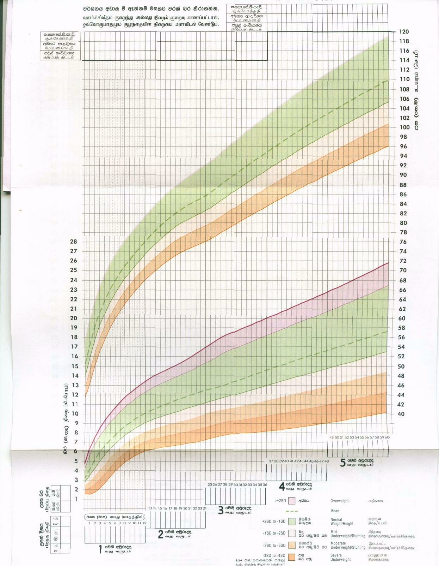
Height
Weight

Slide 19
Growth Chart - New
Separate charts for boys and girls
Weight and height (length) to be measured and plotted

Slide 20
Growth Chart - New
Reference lines
  Mean
  +2SD, +3SD
  -1SD, -2SD, -3SD, -4SD

Slide 21
Mean + 2SD
Mean
Mean – 1SD
Mean – 2SD
Mean – 4SD

Slide 22
Growth Charts
What to measure
How often
Standards used
Reference values

Slide 23
Growth Charts
Shape of the growth curve is more important than its position in relation to the reference values

Slide 24
Growth & Growth Monitoring
What is growth?
Factors affecting growth
Growth monitoring
  What to monitor?
  How often?
  Standards
  Reference values
  Growth charts

